Slide 1

Spotify Global Streaming Data (2024) analysis
Matteo Calloni – Daniel Simontacchi

Slide 2
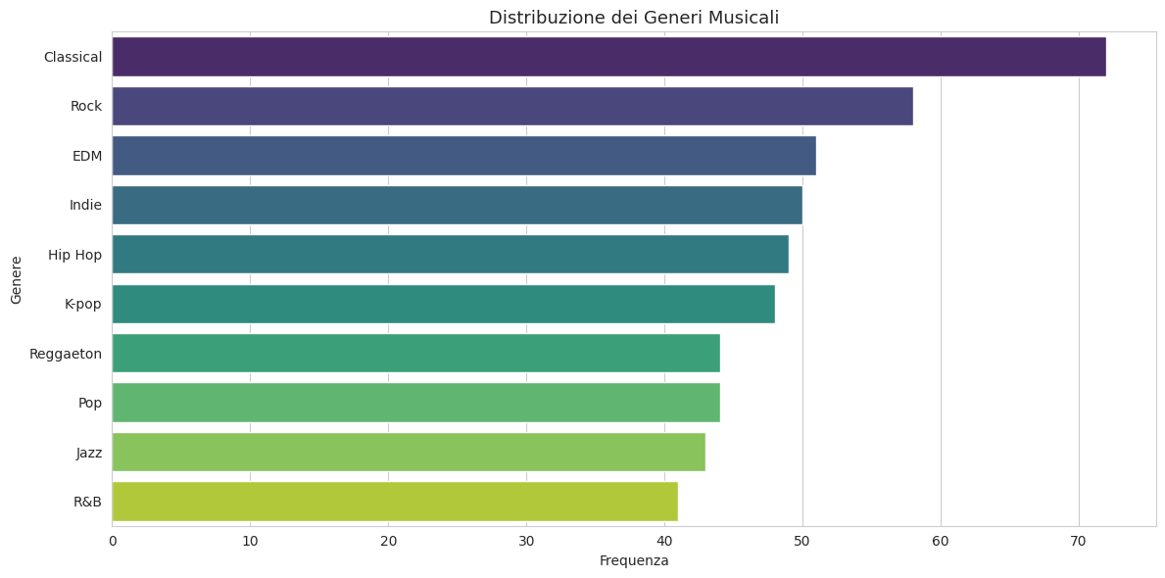
Dataset Composition
Genre Landscape: A diverse mix of Rock, Classical, EDM, and Pop.
Objective: To ensure the analysis is not biased toward a single demographic.
Insight: The dataset covers cross-genre listening behaviors.

Slide 3
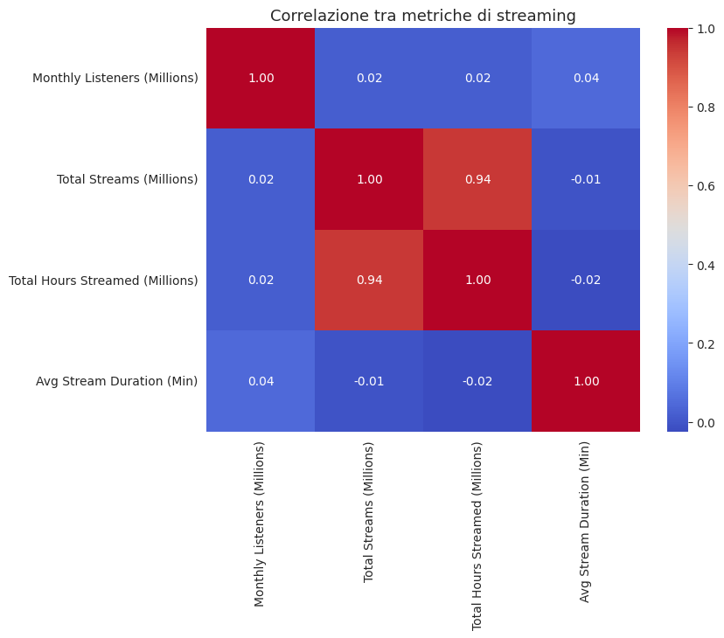
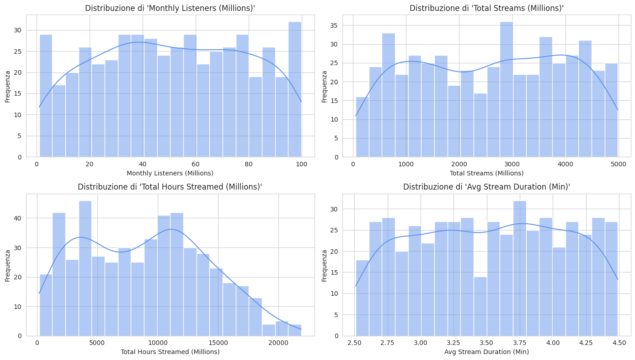
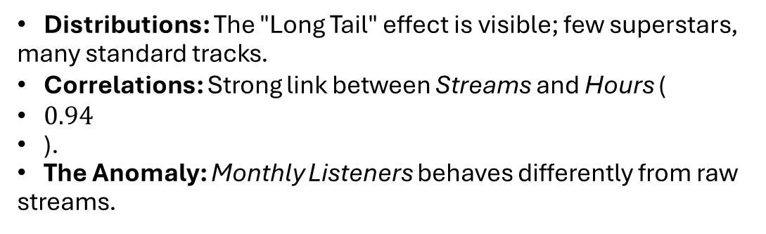
Distribution & Correlation
Distributions: The "Long Tail" effect is visible; few superstars, many standard tracks.
Correlations: Strong link between Streams and Hours (
$0.94$
).
The Anomaly: Monthly Listeners behaves differently from raw streams.

Slide 4
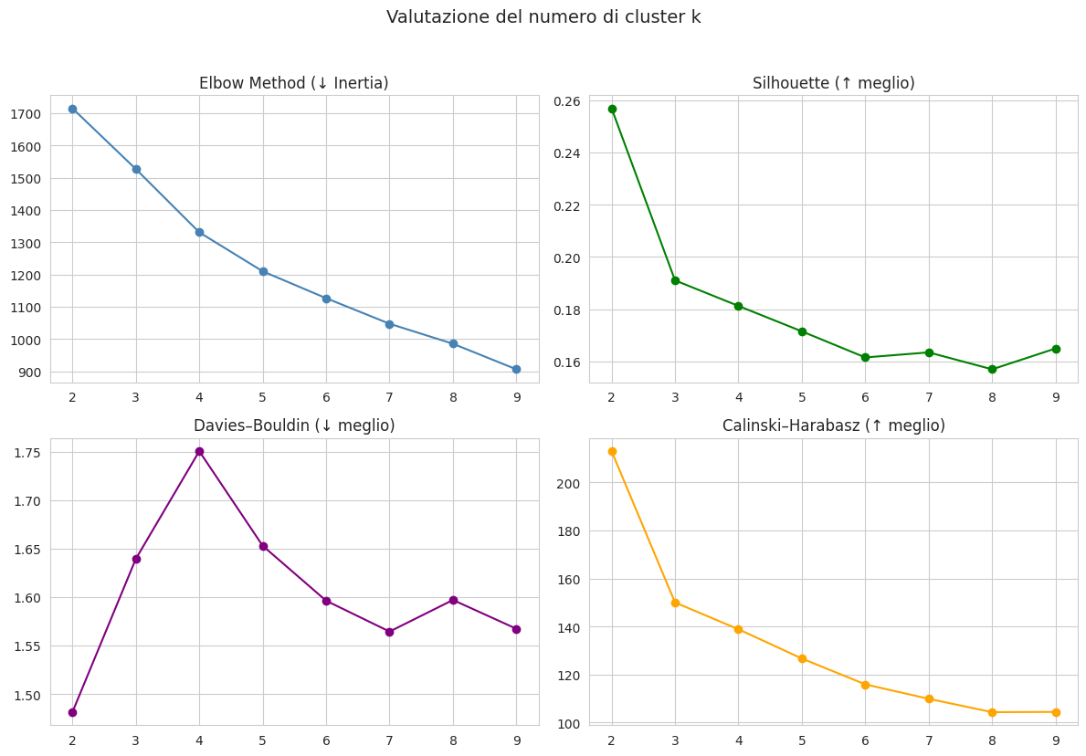

Methodology (Choosing K)
Optimizing K-Means:
Tested $k=2$ to $k=9$.
$k=2$ (Macro): Highest Silhouette score (Clear separation).
$k=4$ (Micro): Best balance for business granularity (Elbow Method).

Slide 5
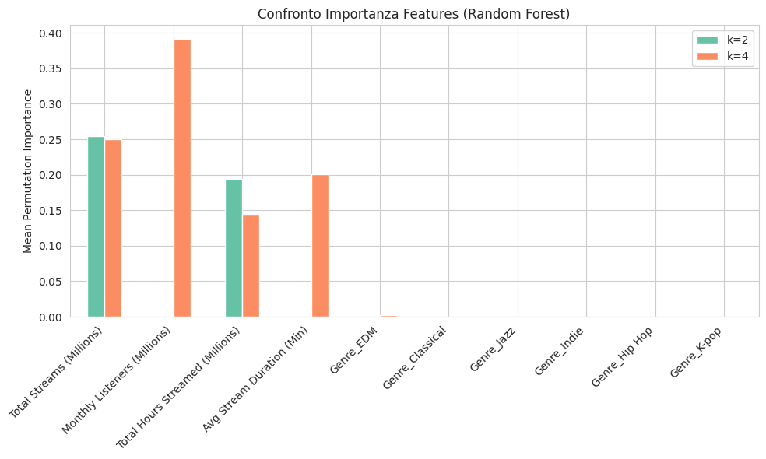
Feature Importance
What drives the clusters?
Key Drivers: Total Streams and Monthly Listeners.
Insight: Genre (low bars on the right) is mathematically irrelevant for defining success tiers.

Slide 6
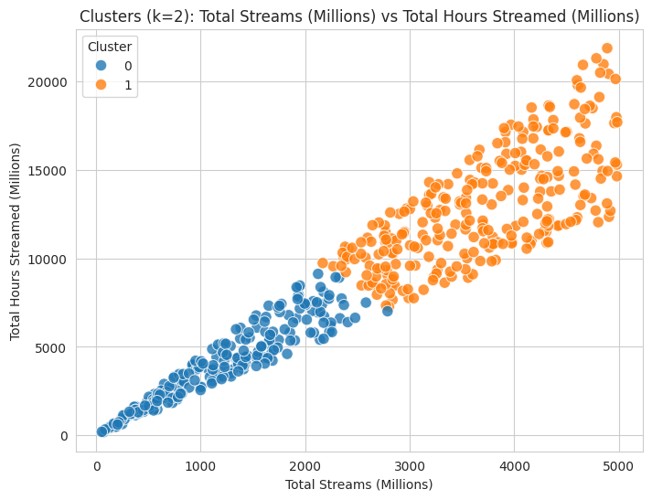
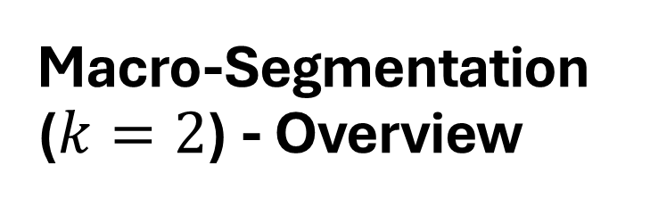
Macro-Segmentation ($k=2$) - Overview
The Binary Split:
Cluster 0 (Blue): Standard Performance.
Cluster 1 (Orange): Elite Performance.
Insight: A linear relationship between effort (Hours) and result (Streams).

Slide 7
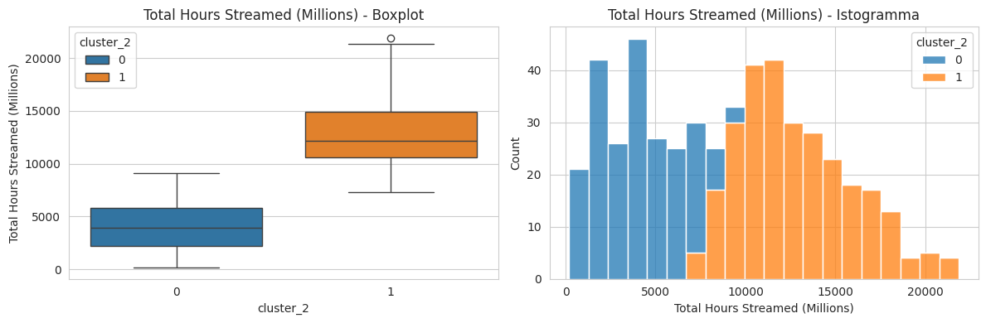
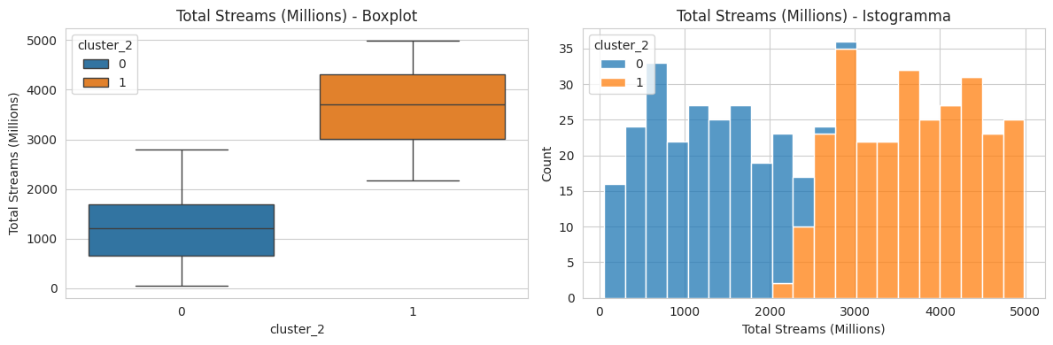
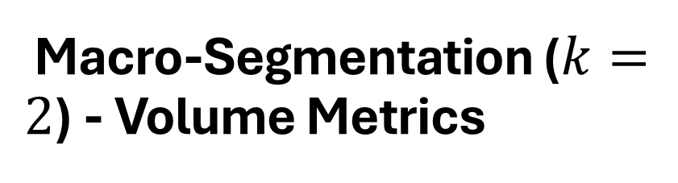
Macro-Segmentation ($k=2$) - Volume Metrics
Deep Dive: Volume:
Gap: Massive separation between the two tiers.
Scale: 'Elite' tracks operate on a scale of Billions, while standard tracks are in the Millions.

Slide 8
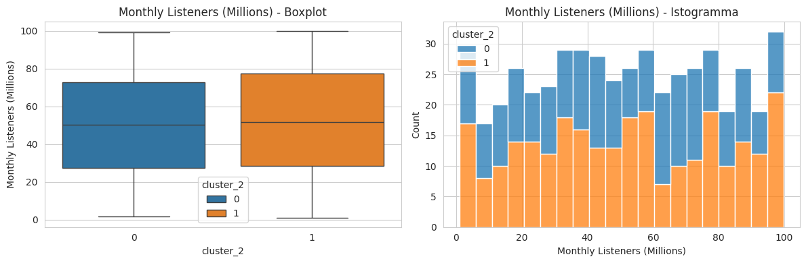
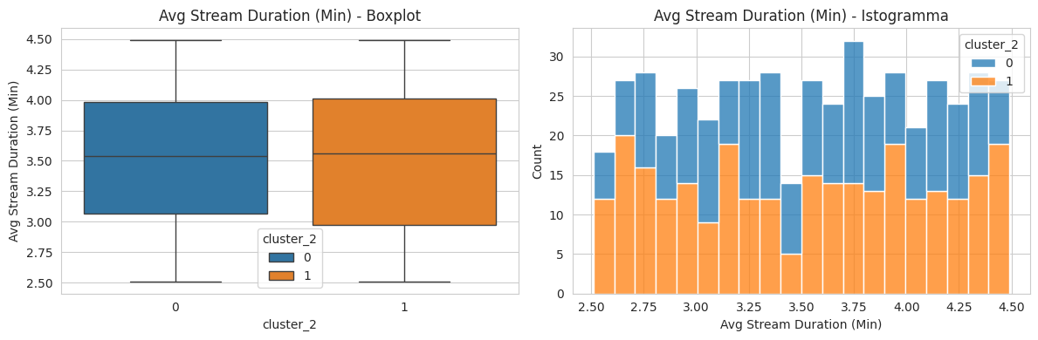
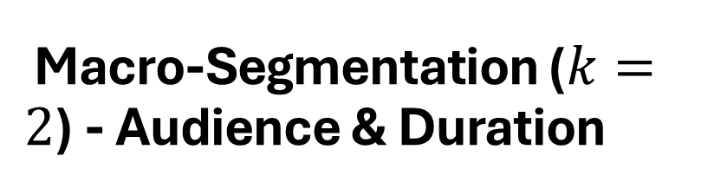
Macro-Segmentation ($k=2$) - Audience & Duration
Deep Dive: Behavior:
Listeners: Elite tracks also command significantly larger audiences.
Duration: Minimal difference in song length between hits and standard tracks.

Slide 9
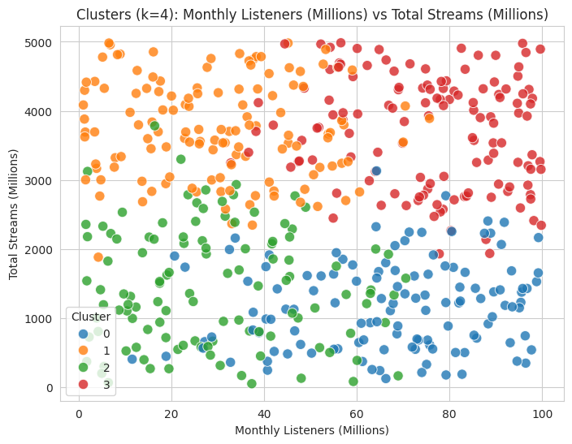
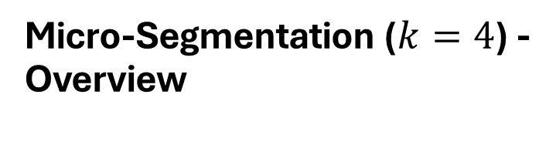
Micro-Segmentation ($k=4$) - Overview
Beyond the Binary:
The linear pattern breaks down.
New Segments: We can now identify specific behaviors, such as "Loyal Fanbases" vs. "Viral Hits".

Slide 10
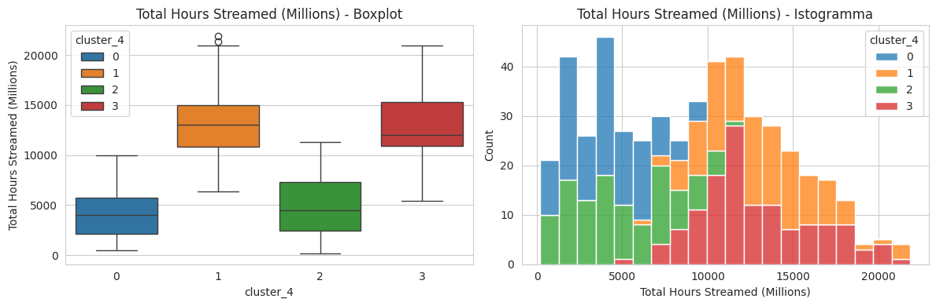
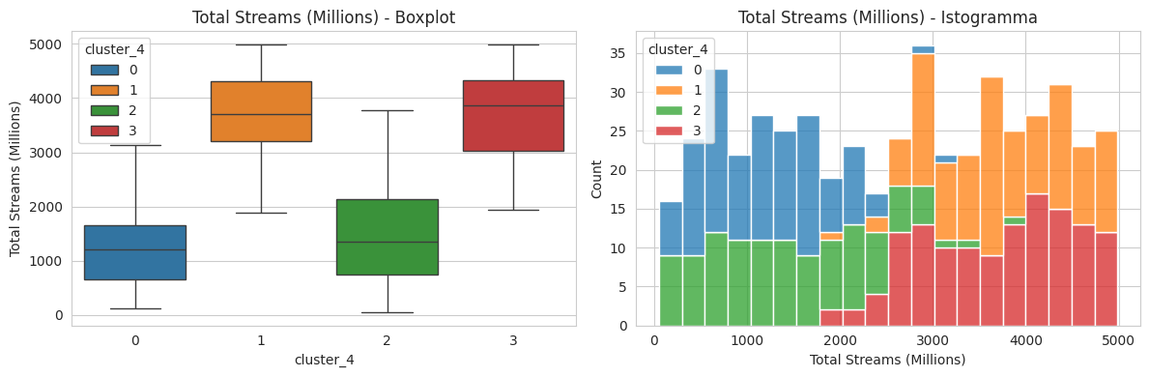
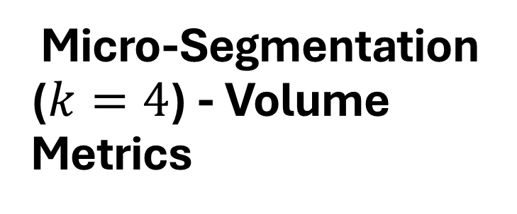
Micro-Segmentation ($k=4$) - Volume Metrics
Defining the Tiers:
Cluster 3 (Red): The "Superstars" (Highest volume).
Cluster 1 (Orange): The "High Performers".
Cluster 0 & 2: The developing tracks.

Slide 11
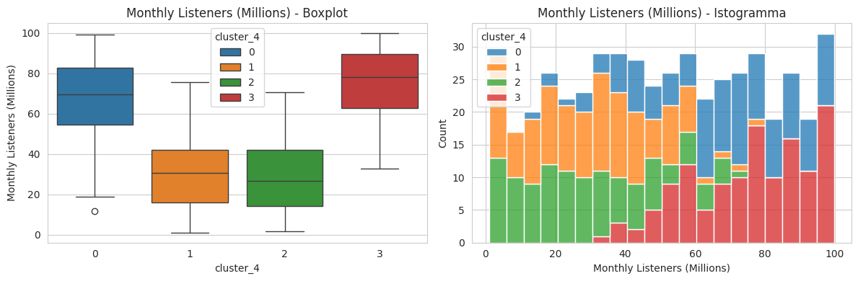
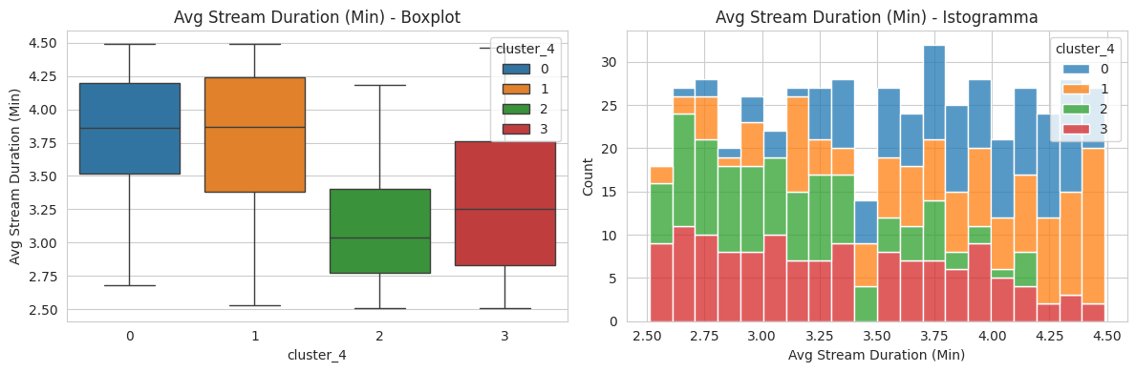
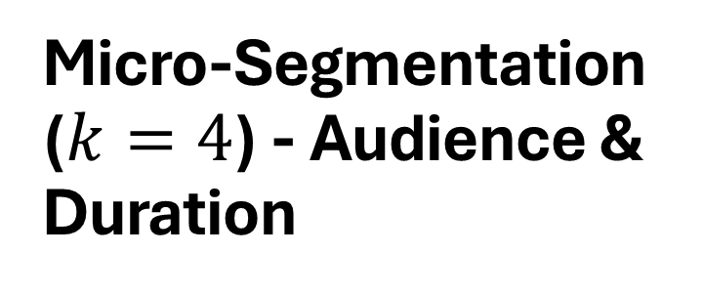
Micro-Segmentation ($k=4$) - Audience & Duration
Nuanced Behavior:
Listeners: Some clusters show high streams but moderate listener counts (High Retention).
Duration: The "Superstar" cluster shows a specific distribution in duration, slightly different from the lower tiers.

Slide 12
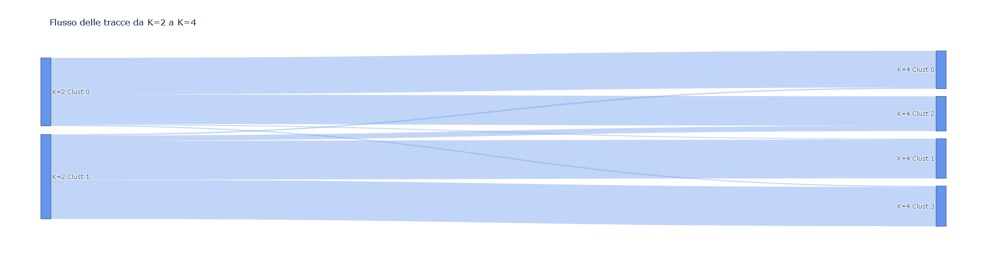

The Evolution (Sankey Diagram)
Trace Flow:
From Macro ($k=2$) to Micro ($k=4$).
Discovery: The "Standard" group (Blue, Left) splits into three distinct sub-tiers on the right.
Strategy: Identify "Standard" tracks with the potential to jump to the next tier.

Slide 13
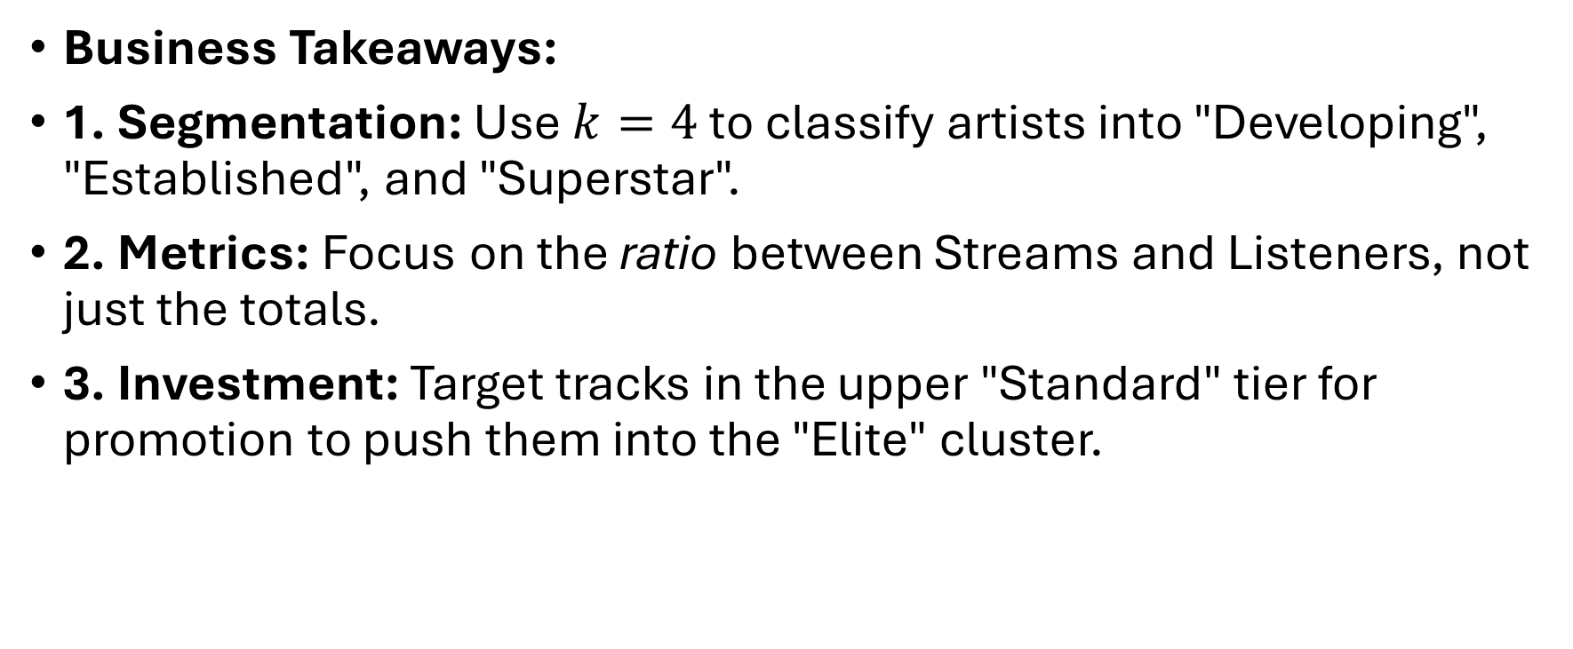
Conclusions & Recommendations
Business Takeaways:
1. Segmentation: Use $k=4$ to classify artists into "Developing", "Established", and "Superstar".
2. Metrics: Focus on the ratio between Streams and Listeners, not just the totals.
3. Investment: Target tracks in the upper "Standard" tier for promotion to push them into the "Elite" cluster.

